Slide 1
Patient Blood Management
What Healthcare Executives Need to Know

Slide 2
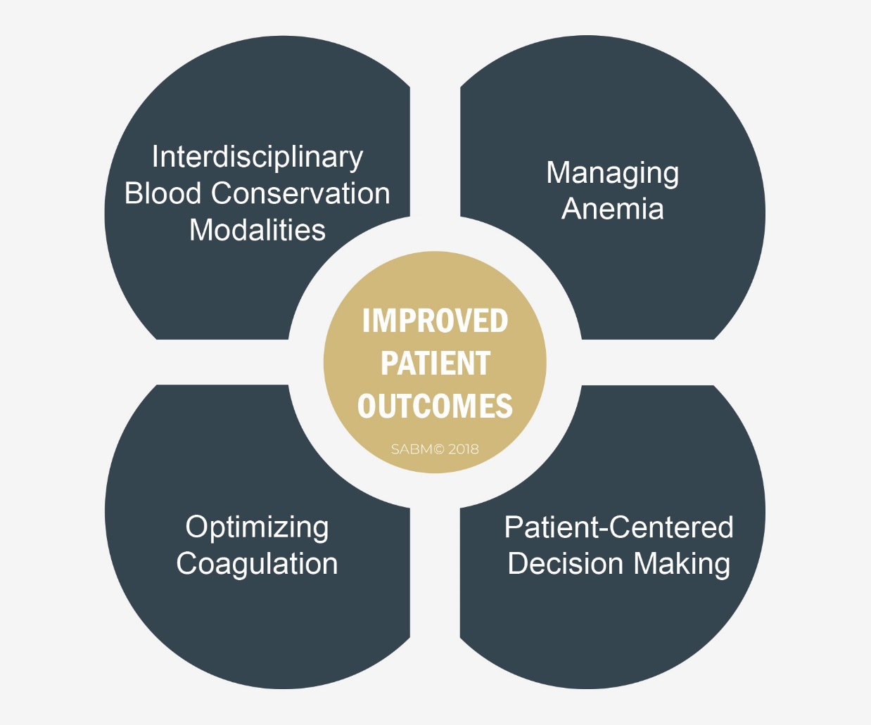
What is Patient Blood Management?
Patient Blood Management (PBM) is the timely application of evidence-based medical and surgical concepts designed to maintain hemoglobin concentration, optimize hemostasis and minimize blood loss in an effort to improve patient outcomes.

Slide 3
Patient Blood Management benefits
Improves patient outcomes.
  Fewer complications.
  Decreased morbidity and mortality.
Reduces waste and costs.
Improves efficiency and quality.
Improves patient experience.

Slide 4
Pbm and patient outcomes
Event
Transfusion
Mortality
Average LOS
Reoperation
Readmissions
Complications (composite morbidity)
Complications (infection rate)
Costs
Reduction
10-95%
up to 68%
16-33%
up to 43%
up to 43%
up to 41%
to 80%
10-24%
Lapar 2103, Kotze 2012, Moskowitz 2010, Reddy 2009, Brevig 2009, Ferraris 2007, Wong 2007, Ghiglione 2007, Freedmand 2007, Martinez 2007, DeAnda 2006, Freedman 2005, Pierson 2004, Kourtzis 2004, Morgan 2004, Slappendel 2003, Van der Linden 2001, Helm 1998

Slide 5
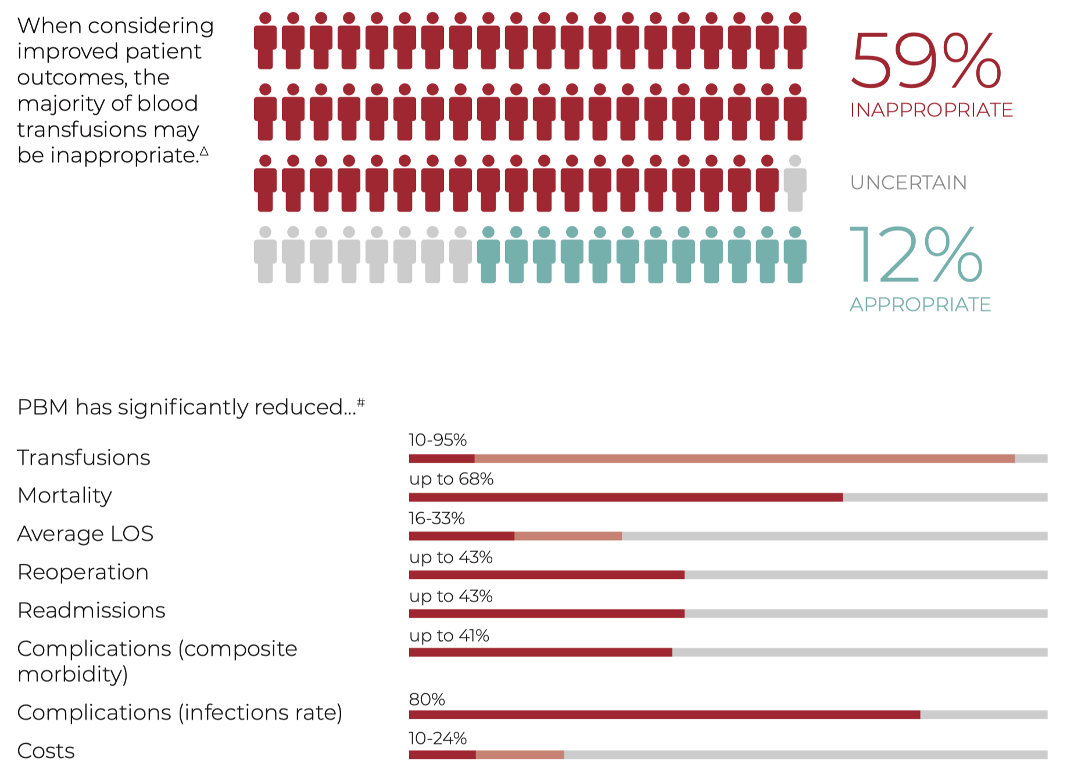
SOURCE: SABM Executive Guide for Patient Blood Management Programs©, 2019

Slide 6

Aligns with regulatory compliance
Fiscally responsible.
Clinically superior.
Patient-centered.
Patient Blood Management aligns with value based reimbursement and quality models.

Slide 7
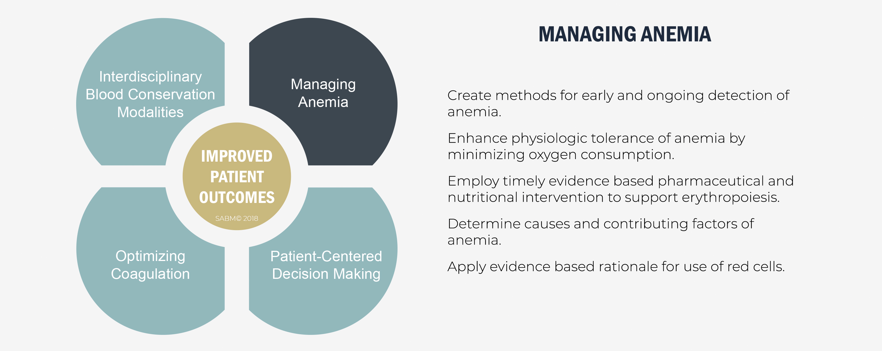
PBM Foundational Principles

Slide 8
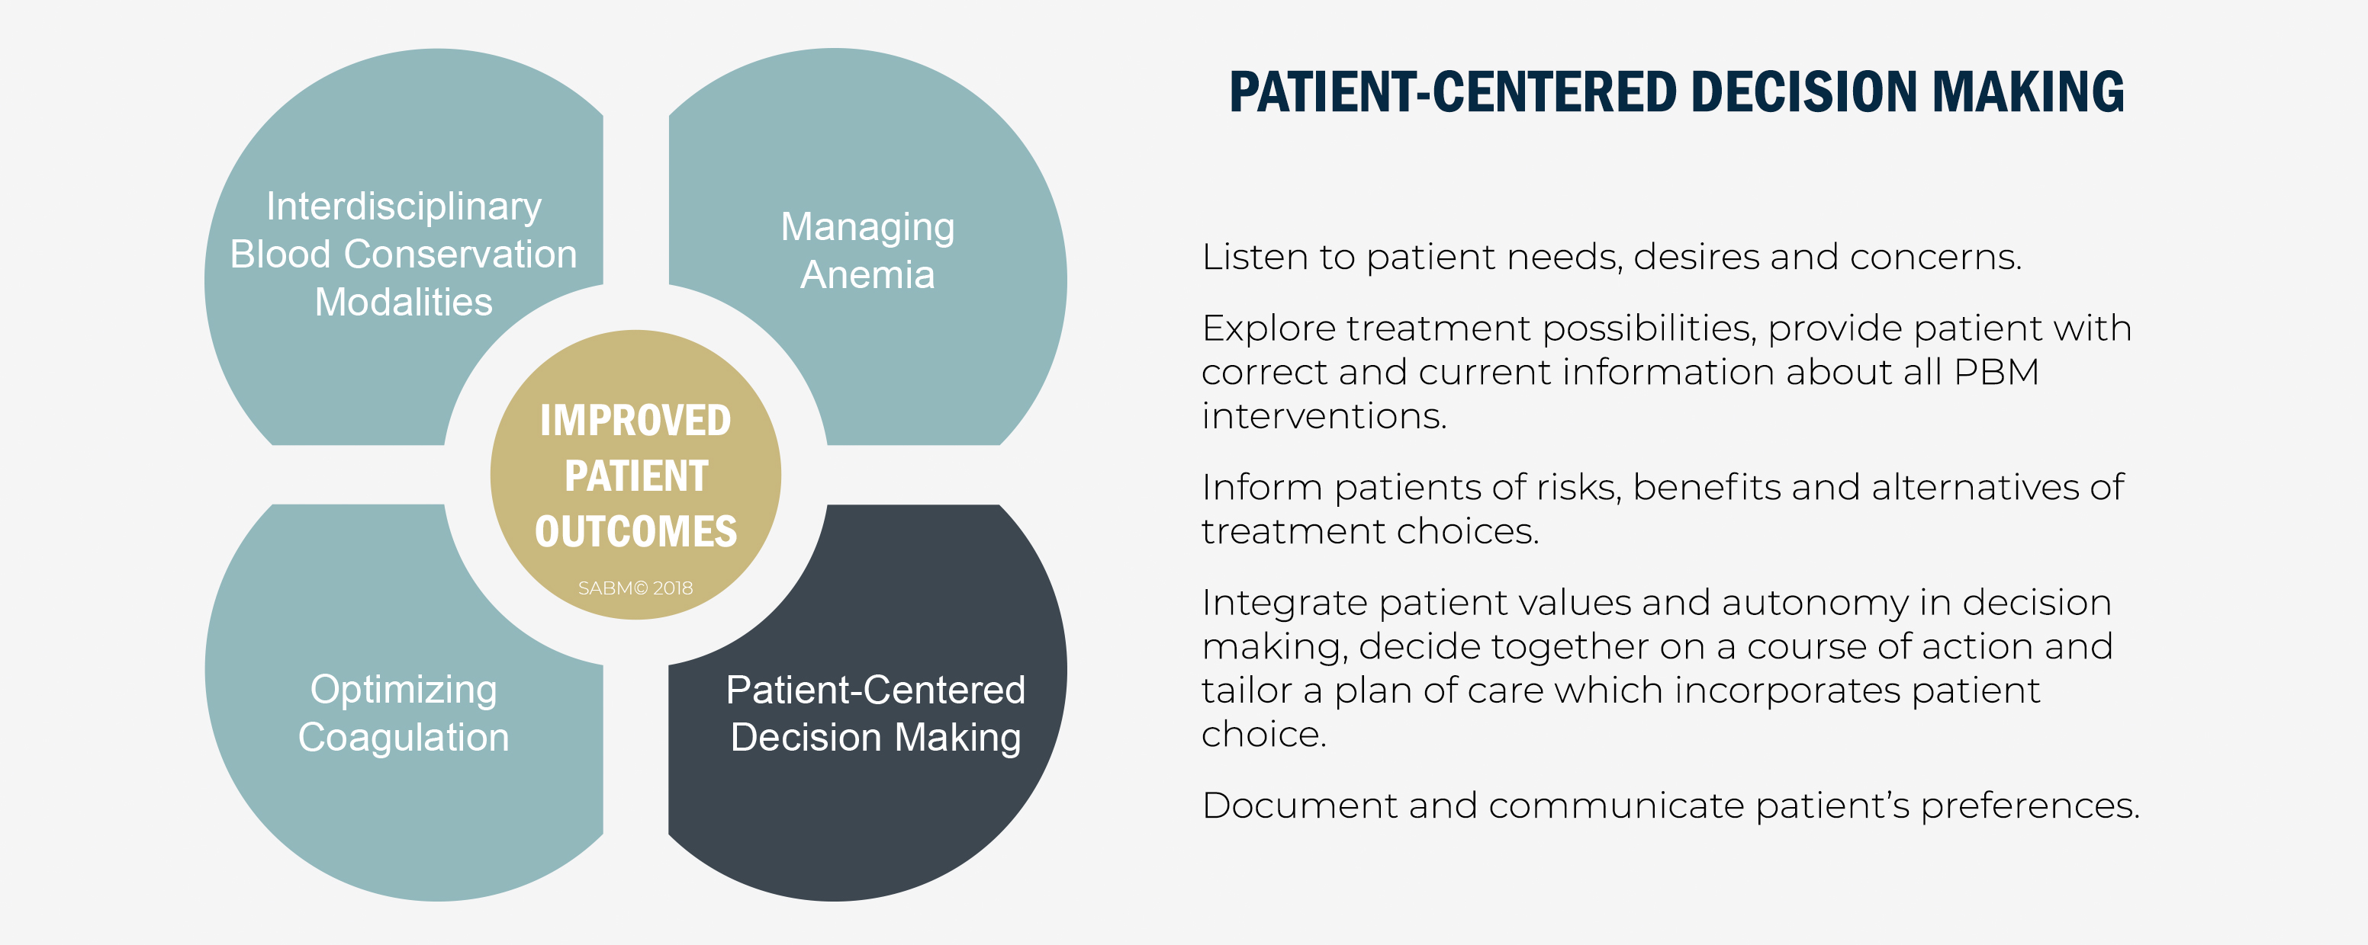
PBM Foundational Principles

Slide 9
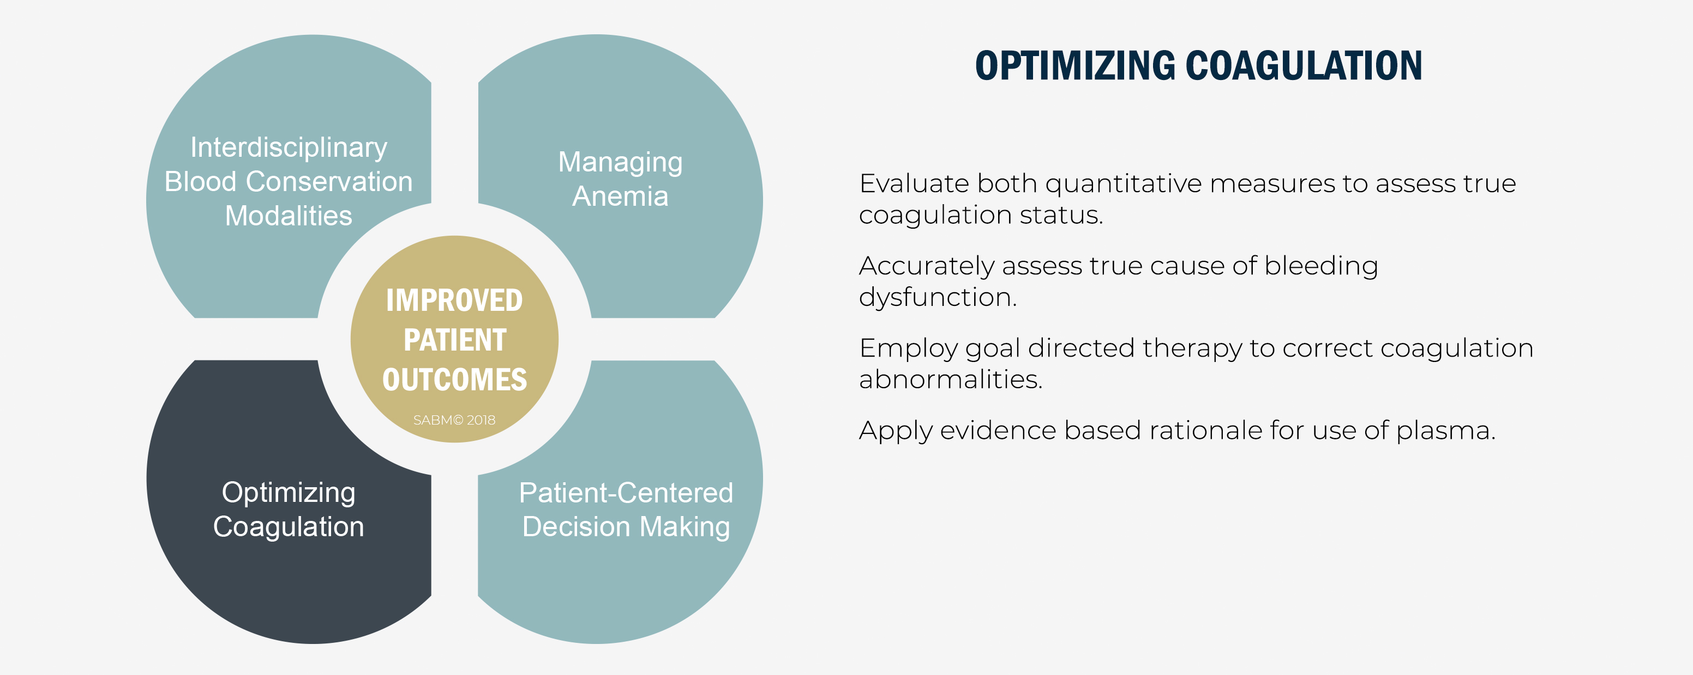
PBM Foundational Principles

Slide 10
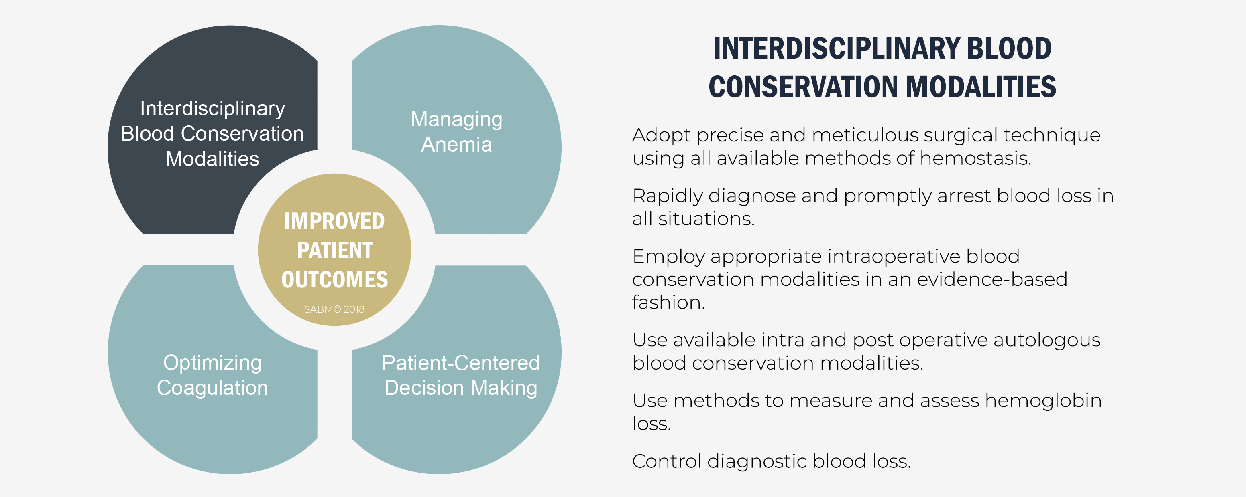
PBM Foundational Principles

Slide 11
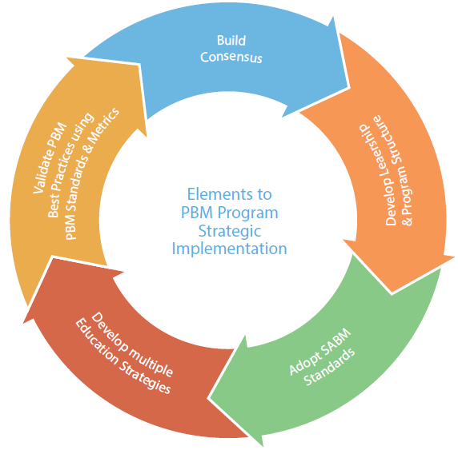

Slide 12
PBM Program Essential Resources
SABM Executive Guide for Patient Blood Management Programs©
SABM Standards and Quality Guide
SABM Online PBM Certificate Course with CME/CE
The Iron Corner
SABM Annual Meeting
Go to www.sabm.org

Slide 13
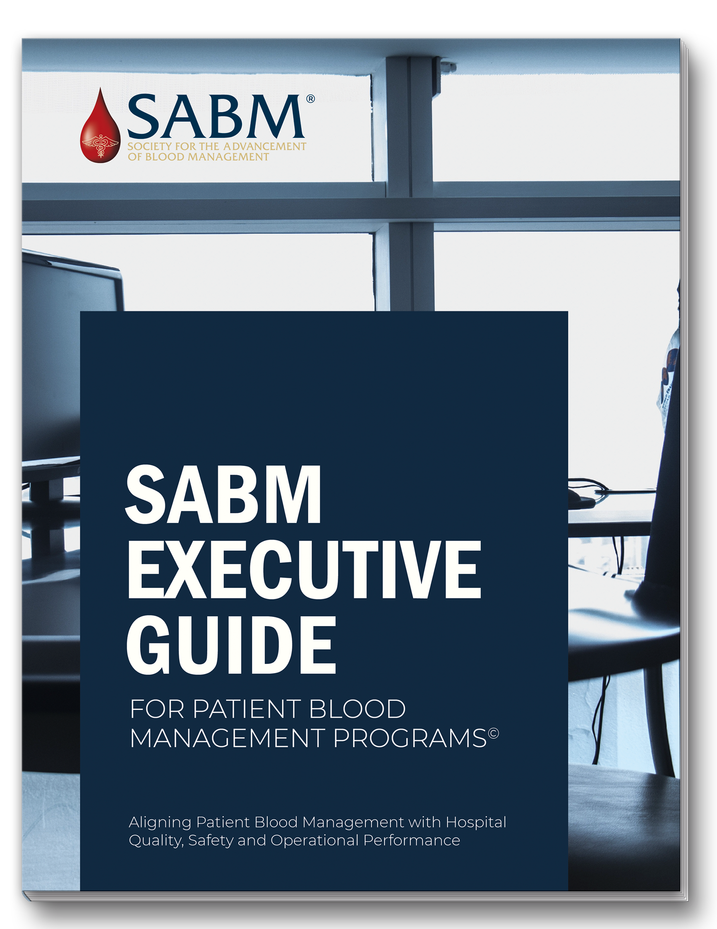
Your guide to establishing a successful Patient Blood Management Program.
From PBM Metrics to Key Performance Indicators.
Available at: sabm.org/publications

Slide 14
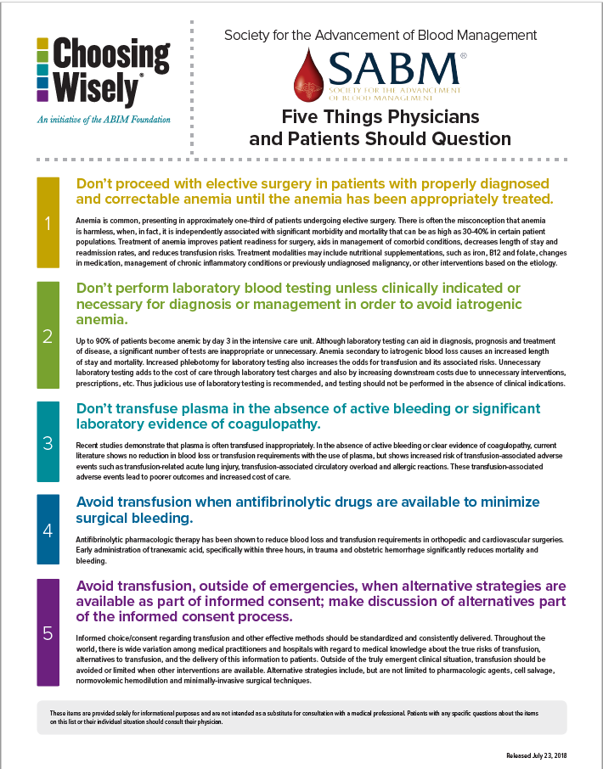
Download Five Things Physicians and Patients Should Question in English or Español.
Sabm.org/publications

