Slide 1
What is Patient Blood Management?
A Patient Guide

Slide 2
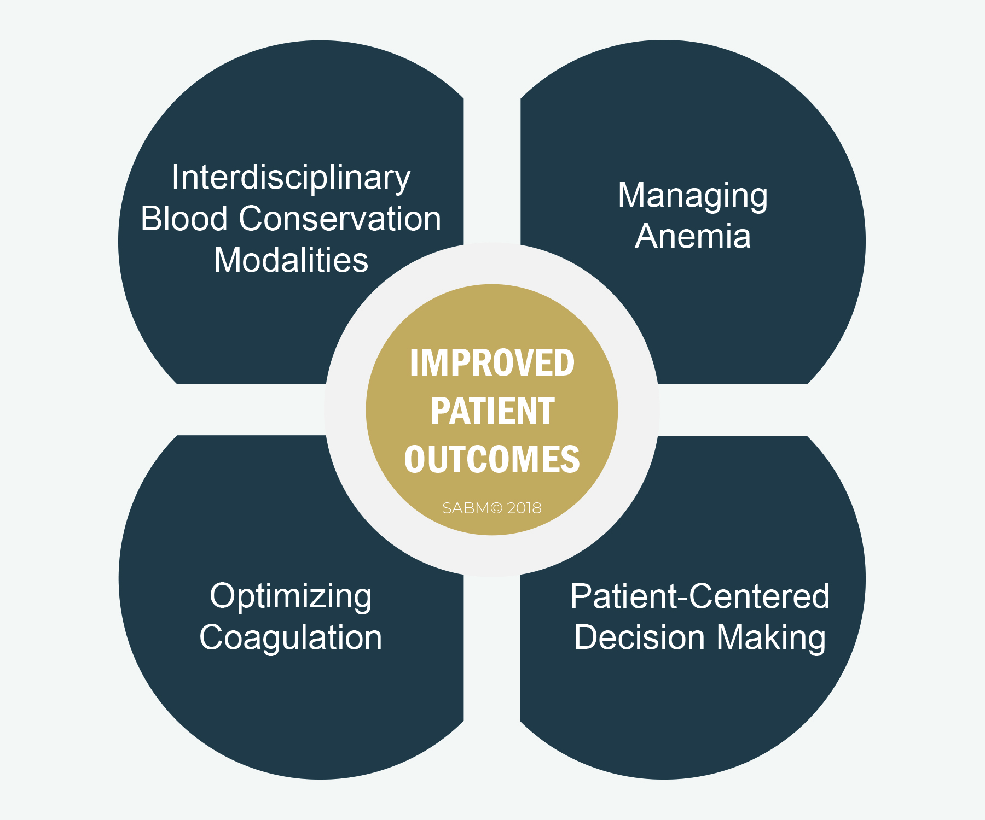
What is Patient Blood Management?
PUBLIC DESCRIPTION
Patient Blood Management (PBM) is the scientific use of safe and effective medical and surgical techniques designed to prevent anemia and decrease bleeding in an effort to improve patient outcome.

Slide 3
Why Patient Blood Management?
Ensures that the decision to transfuse blood is made with careful attention to the risks and benefits for each individual.
Informs patients and encourages their participation in transfusion decisions.
Uses state-of-the-art techniques to avoid the need for blood transfusion.
Minimizes unnecessary sources of blood loss.
Uses advance planning to build blood counts before procedures.

Slide 4
Why Patient Blood Management?
Conserves a precious community resource.
Reduces unnecessary hospital & patient care costs.
Improves patient safety by minimizing exposure to blood.
Can reduce the risk of hospital-acquired complications and infections.
Increasing consumer interest in safety.

Slide 5
Helping Patients Become Educated Consumers
Download SABM’s A Guide to Patient Blood Management
at SABM.org > Publications

Slide 6
PBM Conserves Blood Supply
Predictable drops in donations during:
  Busy summer vacation months.
  Holiday seasons / 3-day weekends.
  Bad weather or disaster situations.
Fewer eligible donors as pre-donation questions are added to predict donor risk for rare infections.
Changing perception of social responsibility among new generations of donors.

Slide 7
PBM in surgery
Peri-operative
Maximize & conserve blood production after surgery.
Minimize blood loss during surgery.
Optimize patient before surgery.

Slide 8
PBM surgical Strategies
Optimize patient before surgery.
Assess patient fitness for surgery.
Correct bleeding disorders.
Assess medications and herbs that increase bleeding.
Correct anemia.
Develop individualized plan of care.
Adapted from Goodnough LT, et al. Transfusion. 2003;43:668-676.
Notes:
Strategies to reduce surgical patients’ exposure to allogeneic blood can be broken down into those that are appropriate during the preoperative, intraoperative, and postoperative periods.

Slide 9
PBM surgical Strategies
Minimize blood loss during surgery.
Precise surgical technique.
Surgical devices that control bleeding.
Drugs that control bleeding.
Minimally invasive technology.
Anesthesia & fluid management.
Blood salvage.

Slide 10
PBM surgical Strategies
Maximize & conserve blood production after surgery.
  Monitor and correct bleeding.
  Tolerance of permissive anemia.
  Increase patient blood production.
  Minimize blood sampling.

Slide 11
PBM Programs: A Team Approach
Pre-Operative
Internist, Primary Physician
Surgeon
Intra-Operative
Anesthesiologist
Surgeon
Post-Operative
Surgeon
Intensivist/ Hospitalist
Perfusion (CV)
Nursing
Nursing
Specialists

Slide 12
PBM Programs
A hospital-based philosophy that
every drop of blood counts

Slide 13
PBM Programs:
Administrative and Clinical Essentials
Physician leadership and expertise.
Core patient blood management team.
Hospital-wide blood conservation policy and protocols.
Continuing education for physicians and nursing.
Community and patient education.

Slide 14
PBM Programs: Administrative and Clinical Integration
  PBM Programs are more successful when everyone works together:
  Administration
  Physicians
  Nurses
  Patients

Slide 15
PBM —What Can Patients Do to Improve their Outcomes?
Are you willing to investigate low red blood cell count (anemia) and take the time to correct it with iron, vitamins or growth factors before coming to the hospital?
Are you willing ask your physician about patient blood management strategies early before surgery?
Are you willing to consider the washing and recycling of your own blood during or after surgery if appropriate?
Are you willing to ask your physician if minimizing blood draws is right for you?

Slide 16
PBM: What Can Patients Do to Improve their Outcomes?
Choose a doctor who will work with you.
Know your blood counts.
Have your doctor explain the risks and benefits of your decision so you can make a choice that’s good for you.
Choose a hospital with a patient blood management program in your area @ www.sabm.org.

Slide 17
PBM Realities
Patient blood management options should be a part of making good health care choices.
Building up blood counts before surgery may help you to avoid a blood transfusion.
Sometimes, several patient blood management strategies can be used at the same time to avoid a blood transfusion.
No single approach (drug, device, technique) is effective for everyone.

Slide 18
PBM Programs: Why Hospitals Embrace a Blood Conservation Culture
  Responsive to public concern over blood safety.
  Sustains the blood supply.
  Improved technology, devices and pharmaceuticals.
  Imperative to reducing hospital costs.
  Increases hospital through-put (fast-track).
  Improves physician skills.
  Improves patient care.
  Gives recognition as a “Best Practices” hospital.
  Enhances need to be stay on the cutting edge.
Cardiothoracic and Vascular Anesthesia, Vol 18, No 4 (August Supplement), 2004: pp 15S-17S+

